Slide 1



Zoom
Teacher
Training
Notes:
Welcome to Zoom Teacher Training. LEARN uses Zoom throughout our organization for online classes during the day, LEARN Tutoring, and meetings at a distance. In this presentation, we will share how we use Zoom for teaching and learning.

Slide 2

Teacher training plan:
We will walk you through every step! Please follow our lead even if you consider
yourself to be a Zoom expert at this point.
What to expect when you first enter Zoom.
Console tools:
  Audio test
  Participant list controls
  Chat features
  File transfer
  Screen sharing
  Whiteboard
  Breakout Rooms
3. Updates and additional Zoom training
4. Support
Notes:
During this training session, we will walk you through every step. We will cover the basics, such as (1. Read it, 2. Read it ) and then provide you with information about updates, additional Zoom training and where you can find support.

Slide 3


Getting Started with Zoom
Teachers in Zoom will have a URL, or invitation link, that can then be shared with students.
Students will be required to click on the link provided OR copy and paste it into their browser’s address bar. Chrome, Firefox and Safari are all supported.
For more, students can access participant guides at learnquebec.ca/onlinesolutions.
Notes:
Teachers will have a Zoom link that they will be able to send to students. Students are easily able to use the link to access the meeting/class session. We strongly recommend downloading the Zoom app. If unable to download the Zoom app, users must access Zoom from Chrome browser.

Slide 4
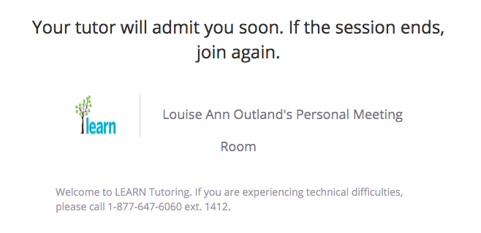
Waiting Room (Student view)
Your teacher will admit you soon.
Your teacher will admit you shortly.
Teacher’s Personal Meeting Room
Notes:
If a participant clicks on a Zoom meeting link and the teacher has not yet arrived, the student cannot enter the space. Students will know that they are in the right place, though, with this default message that will list the teacher’s name.

Slide 5
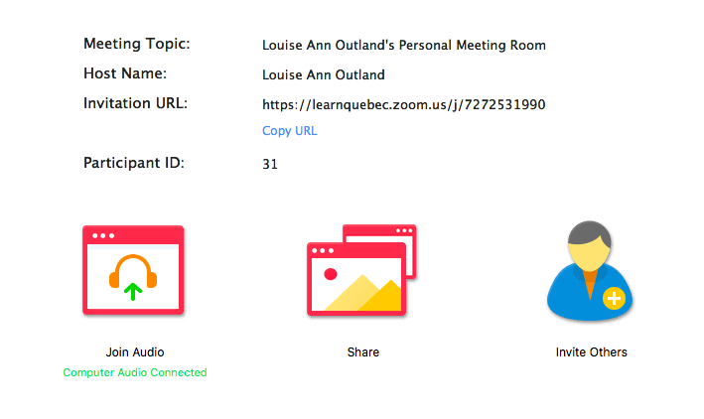
When you first connect in Zoom
Notes:
When you first connect in Zoom, your students will see the following should you not be sharing anything on the screen. Please always prompt them to join audio as it is always off by default.

Slide 6
Controls - Start by clicking on Chat & Participant
Attendee controls:
Mute / Unmute: Mute and unmute your microphone. (Note that microphone is muted by default and students will have to be told to join audio or unmute to speak AND to hear.)
Start Video / Stop Video: Turns your camera on or off.
Invite: Invite others to join your meeting.
Participants: See who's currently in the meeting.
Share Screen: Start a screen share (if the host allows).
Chat: Access the chat window to chat with the participants.
Additional controls for host/tutor (circled in red):
Record: Please do not record your sessions unless you feel that it is absolutely necessary.
End Meeting (as opposed to Leave Meeting): To end the meeting, simply click on End Meeting.
Notes:
For both teachers and students, Zoom controls will appear along the bottom of the screen at the beginning of the session. By default, microphones are muted. If microphones and webcams are both closed, a diagonal red line will appear over them. To begin speaking to your class, make sure that your microphone icon appears as above without a red line. The microphone icon will show some green in it when you start speaking.
The video icon stops and starts your webcam video. Webcam is optional for teachers, but it may be comforting for your students to see your face at the beginning of the session. We don’t recommend that all students turn on their webcams during the entire class session, as connection may be impacted for some due to bandwidth use. However, students can turn on webcams one at a time for presentations, for example, or to say goodbye to everyone at the end of class.
The invite icon allows you to access the link for your Zoom meeting so that you can share it as needed with students.
We will explore the next three controls, Participants, Share, Chat in detail later in the presentation.
We do not recommend that you record sessions, but if you do, the video file will save to your computer.
Leave meeting is the student control to log out of the Zoom meeting. For teachers, the option will read End Meeting, which allows teachers to end the meeting for all participants.

Slide 7

Testing Audio
Click on “Unmute” button and then speak when the red line disappears.
Click on the arrow beside the Mute/UnMute button to select a different microphone or speaker connected to your computer.
Notes:
Audio in Zoom is muted by default. You will need to prompt your students to select the audio option that is connected to their computer and then to unmute themselves by clicking on the red line over the microphone icon.

Slide 8
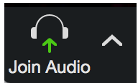
Audio troubleshooting - a few tips
1 - Students who Join with Browser instead of downloading the app, MUST use CHROME. Audio will not work in other browsers.
2 - If no microphone icon is visible for a student in the participant list, he/she will need to Join Audio. This will be visible for the student in the bottom left where the microphone icon would normally be visible.
For more troubleshooting tips, go to - learnquebec.ca/FAQ
Notes:
When students are adjusting to the platform, a common issue is that the student cannot hear or speak. Please note that this issue will be resolved in most cases with one of the two tips here. 1 - For the optimum Zoom experience, participants should use the Zoom app/client, not follow the option they see on login to “join with Browser”. If they are unable to download the app, then they MUST use the Chrome browser when accessing Zoom. 2 - The student must Join Audio to both hear and speak. They will need to click on Join Audio to make sure that their microphone is connected. Some students will not be comfortable speaking online, but they will still need to have joined audio, even if they are always muted and only listening. Chat, which will be described in upcoming slides, may be a preferred option for those students.

Slide 9
Participant/Host Controls
Always click on Chat and Participants buttons when you come into the Zoom class meeting.
This will allow you to chat/type with your students and see the student list, with some additional controls.
Please invite your students to open chat and participants too.
Notes:
From the main control bar you can access the participants list and chat. A good rule of thumb is to click on these to pop them out, in order to see them at all times. Your students should be encouraged to do the same.

Slide 10
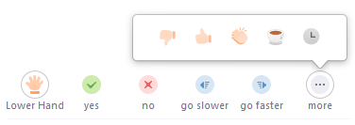
Participant List
The Participant List also gives you access to these options:
Rename: Hover over your name to change how it is displayed to other participants. Please stick to your name.
Non-verbal feedback icons: Places an icon beside your name to quickly notify the host. For example, Raise Hand places the raise hand icon beside your name and simulates a hand raise.
Notes:
From the participant list, teachers and students can edit the names that appear on the list. Simply hover over the name on the list that you wish to change and select Rename. Teachers may wish to use Mr, Ms, Mme etc as part of their participant list name, whatever your students are used to calling you. If students are logging in on a shared family computer, you may want to rename them on the list if their name is displaying as that of another family member.

Slide 11
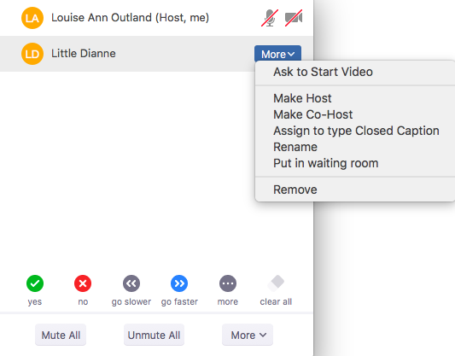
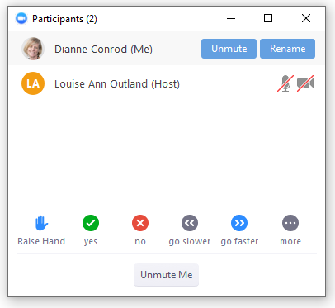
Participant List Controls
Teachers/students can rename themselves.
Teachers can rename a student, remove, or put in waiting room.
Notes:
Teachers have the added control of being able to remove a student or put in waiting room should the need arise. You can also change a student’s status on the fly and make them a host or co-host so that they have added control.

Slide 12
End of Session and student does not leave?
1. Tell student that the appointment time is up and tell them how to leave.
Leave Meeting in bottom right.
2. If student does not leave and another student is waiting, from the drop down beside the student’s name, select Put in Waiting Room or Remove.
Notes:
As mentioned, with your teacher controls through More in the Participant List, you can remove students. This may be necessary due to behavioural problems, or simply that you are starting with another group and a student failed to leave the meeting and log out properly. Click on the remaining student’s name and select more. From the drop down menu, you can select Put in Waiting Room, if you would like to admit the student later, or Remove, if the student needs to leave the meeting and not return for the remainder of the day. Remember that students have to be admitted to the class by the teacher, so the student can not return if you do not want them to.

Slide 13
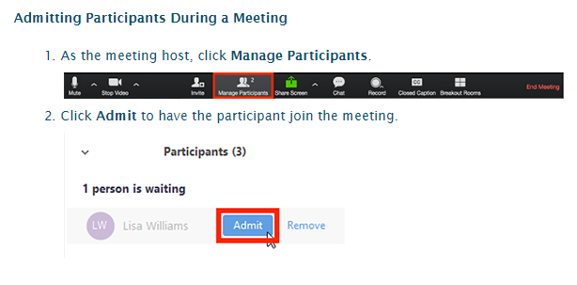
Admitting a student (Teacher view)
You will hear a chime notification when a student enters the waiting room. You can admit students one at a time, or wait until closer to class time and Admit All for a larger group.
Notes:
Your students will need to be admitted to your space from the waiting room. You will see students trickle in via the participants list and hear a chime when they do. You can admit students one at a time, or wait until closer to class time and Admit ALL for a larger group.

Slide 14
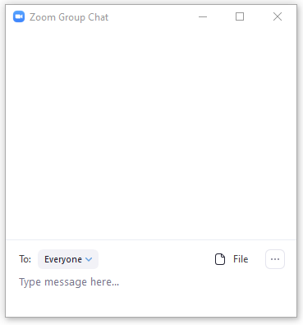
Chat - Pop it out!
Click Chat in the meeting controls
This will open the chat on the right.
Chat settings will follow.
Notes:
Again, a good rule of thumb is pop open the chat in order to see the message list. If you have 2 screens you can pop it out and then swipe it over to your second screen for easy viewing.

Slide 15
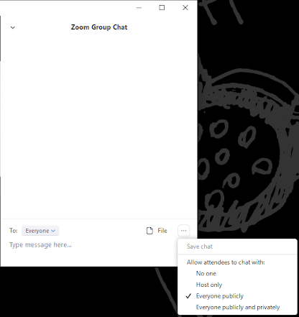
Private Chat
Open Chat
In bottom right, click on 3 dots …
For students to private chat with ONLY the host, “Everyone publicly” must be selected.
Note: This setting has been chosen for you by default.
Notes:
The recommended setting for online classes is to allow private chat between the teacher and each student. With this setting, the students CANNOT private chat with each other, only you the teacher. Select this setting “Everyone Publicly” from the 3 dots at the bottom right of the chat box.

Slide 16
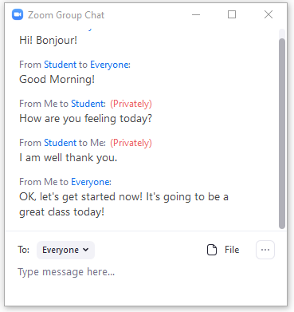
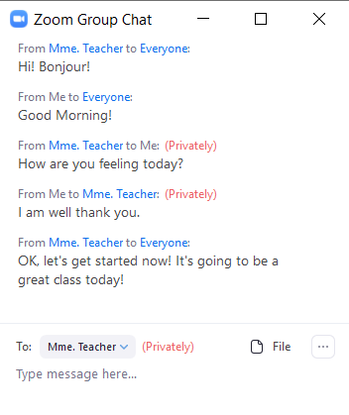
Private Chat in use
Teacher view
Student view
Notes:
To send a private message, click on the student’s name from either the participant list, or their name link in blue from the chat. Note the visual reminder that you are sending a message privately, shown in red.

Slide 17
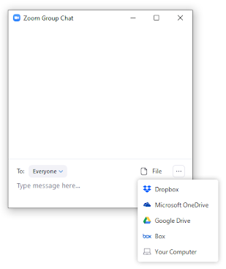
File Transfer
Hosts and students can upload a file directly into the chat from:
Dropbox
OneDrive
Google Drive
Box
OR your computer
Notes:
Sharing files in Zoom can be done via the Chat by clicking on the File icon in the bottom right corner of the chat box and selecting from the dropdown menu. Both teacher and student can upload and share files.

Slide 18
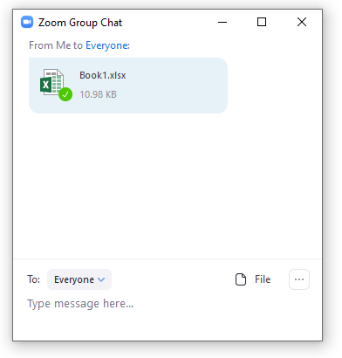
File Transfer
Hosts and students can then download the file directly from the chat.
Just click on the file name to open and save.
Notes:
Any uploaded document that you would like to share with your class can then be downloaded directly from the chat.

Slide 19
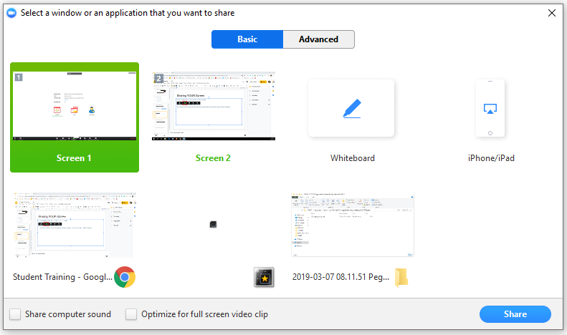
Sharing YOUR Screen
Best practice: Always share something!
In Zoom, anything that you want to SHOW, you have to SHARE.
Click on Share Screen to select the screen showing the document that you would like to share OR select Whiteboard. Click Share.
Notes:
We recommend that you always have something to share with your students. In order to do so, you need to click on the green Share Screen icon in the controls bar, then select the window or application that you want to share from the thumbnails shown. Once you’ve made your selection,click on Share. You students will now be able to see and work with whatever you’ve decided to share. Please note that when you do share your screen, the main controls move to the top of your screen.

Slide 20


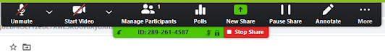
Annotating the shared screen (Teacher view)
Does not work on Chromebooks
Annotation tools appear automatically when sharing a whiteboard.
When sharing another screen, teachers will need to select Annotate from their toolbar.
Notes:
Teachers can annotate ANY shared screen. When sharing a whiteboard, the annotation tools will appear automatically on the sharer’s whiteboard screen.
When sharing any other screen, teachers will need to select Annotate from the tools.
Please note that sometimes, the tools will be hidden and users will need to move their mouse or track pad over the green sharing bar with ID number for the tool bar to be visible.

Slide 21
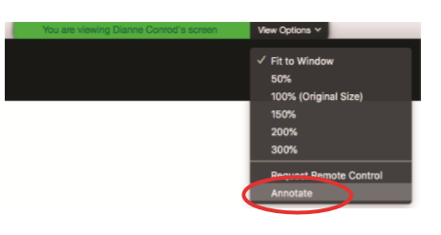
Annotating the shared screen (Student view)
Does not work on Chromebooks
To annotate a shared screen:
At the top of your screen,
click View Options.
Click Annotate.
This will open the annotation tools.
Close the annotation tools at any time by clicking the X in the annotation toolbar.
Notes:
Students can interact on the shared screens too. Teachers need to be able to show the students how to open the Annotation Tools. When they are viewing your shared screen, they will click on View Options beside the green screen sharing bar. If you are sharing your screen, you, as the sharer, will see the option to Disable Annotation so the students can no longer write on the screen.

Slide 22
Annotation Tools
Zoom offers the basic annotation tools.
Click on the tools from your toolbar for more options.
To move from writing on the screen to using your computer controls, click on Mouse.
The toolbar can be dragged around if it gets in the way of something that you are sharing.
Notes:
From Zoom’s annotation toolbar, you can type and draw on the screen, add arrows or other shapes, erase, change colour and size, as well as undo and redo actions.
The tools all have additional options that are visible when you click on them.

Slide 23


Screen sharing - Moving from one screen share to the next…
While sharing, click on Pause Share. Participants will continue to see the current share while you select your new screen.
You will see that “Your screen sharing is paused”. Now click on New Share and select the new screen that you would like to share next.
Notes:
Often in the course of a class, a teacher will need to shift from showing a document to sharing a whiteboard. By pausing and resuming your share, you can select the screen to be shared in the background, making the transition seamless for your students. Attempt this only when you have become reasonably comfortable with the sharing feature. It take a little practice, but the steps are all outlined on this and the following slide.

Slide 24
Screen sharing - Moving from one screen share to the next…
3. Select the new screen that you wish to share from the thumbnail choices and click on Share…
4. Now click on Resume Share.
5. Your New Share will now be visible to participants.
Notes:
Once you have paused your share, choose a new window or application to share, select and then resume share. Your new share will now be visible to your students.

Slide 25
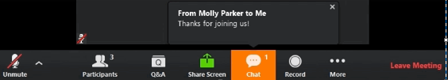
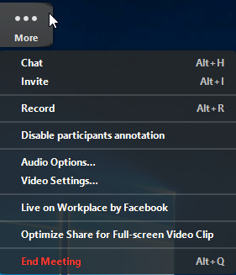
When you start sharing your screen, your chat and participant list will disappear.
You can click on chat again and a floating chat window will appear.
If you receive new chat messages while in screen share mode, the More button will flash orange to indicate the incoming message. You can click on More, then Chat to open the window.
Notes:
Something that can throw off the beginner Zoom user is that when you are sharing your screen, your chat and participant list will disappear. Simply drag your mouse or trackpad towards the top of your screen, above the green bar showing your meeting ID, and the controls will reappear. Click on the participants icon again and look for chat in the more section to open it again.

Slide 26
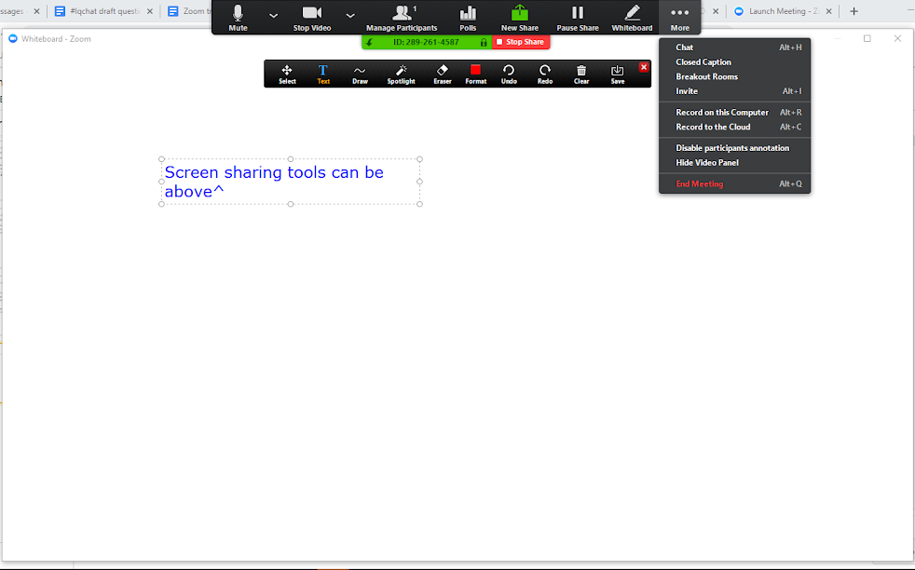
Screen sharing menu… you can move it!
Notes:
As mentioned earlier, when one is screen sharing, the controls move to the top of the screen. If the controls are in the way of something that you would like to share, simply move them to the bottom. Click on the small arrow on the green screen sharing bar.

Slide 27
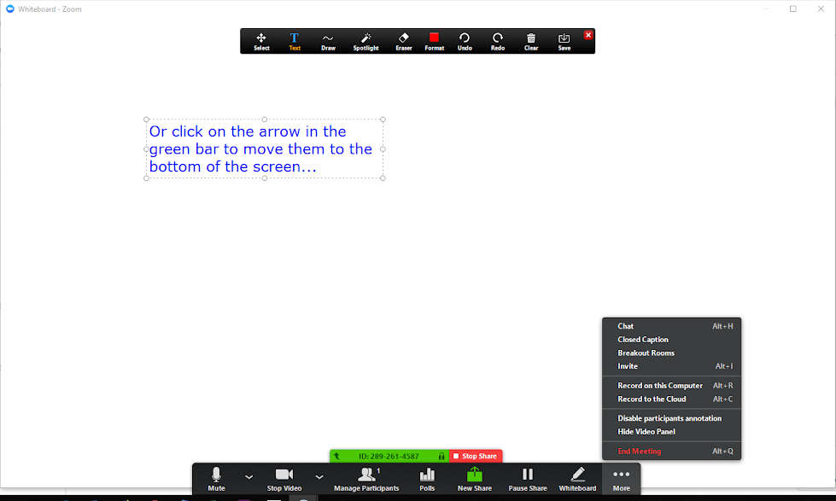
Screen sharing menu… to the bottom :)
Notes:
And the controls will move to the bottom instead!

Slide 28
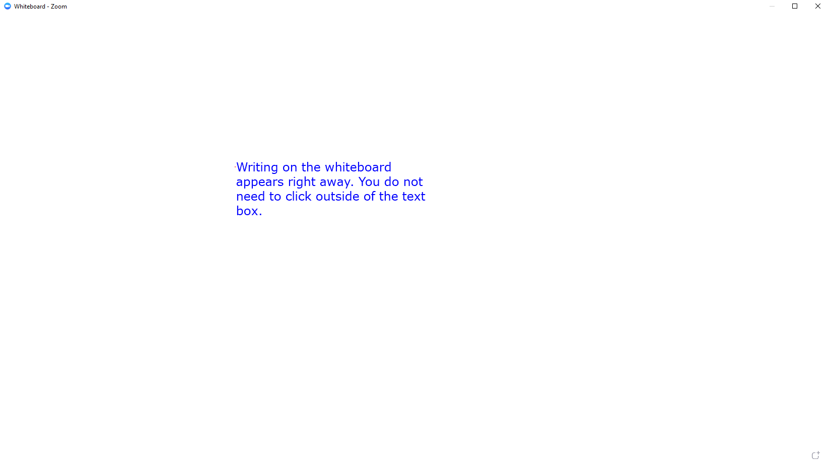
Add another whiteboard page when sharing
Notes:
The whiteboard feature allows for the sharer to add pages. To add another whiteboard while sharing, simply click on the tiny add whiteboard icon (circled in red here) on the bottom right hand corner of the screen. This will add a page and then allow you to easily toggle back and forth between whiteboards.

Slide 29
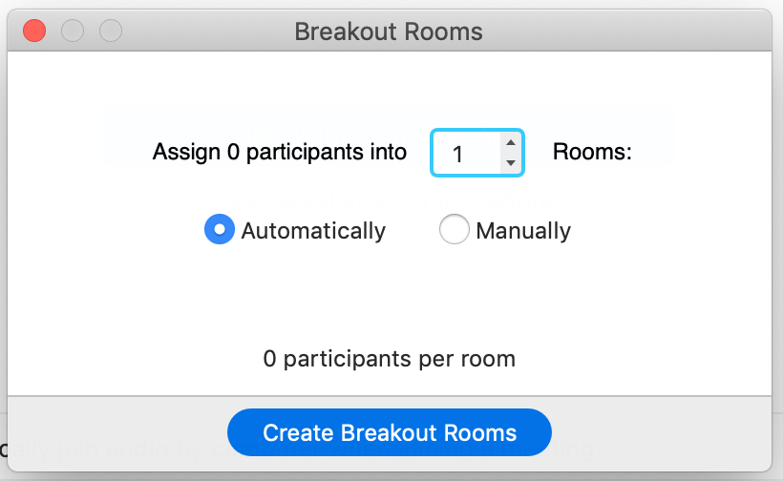
Let’s try Breakout Rooms!
In Zoom, you can create breakout rooms to support small groups working independently.
Click on the Breakout Rooms icon on your control bar and either automatically or manually select the number of rooms you need.
If you need to communicate with your students, you can broadcast to all from the main classroom. Direct communication with individual students, needs to happen in the breakout rooms, which requires a visit.
Notes:
Zoom allows you to create, and add students to, break out rooms for individualized group work sessions. Click on the Breakout Rooms icon on your control bar and either automatically or manually select the number of rooms you need.
If you need to communicate with your students, you can broadcast to all from the main classroom. Direct communication with individual students, needs to happen in the breakout rooms, which requires a visit.

Slide 30
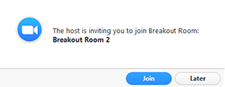
Once invited by the host, students will need to to join the breakout room by clicking on Join from the pop up. | In the breakout room, students will have full controls to: Mute/Unmute to speak Start/Stop Video Participants - view the Participants list Share screen Chat - type messages to the other participants in your breakout room Record - you can record the Breakout Room locally if the host gives you recording permission Ask for Help - request help from the meeting host
Notes:
Students will receive a pop up notification when they have been invited to join a breakout room. They will need to click on Join to enter the room.
Within the Breakout Room, they have full access to participant controls.

Slide 31
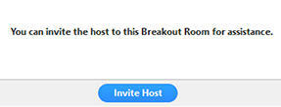

Support in Breakout Rooms
If you click Ask for Help, the meeting host will be notified that you need assistance and will be asked to join your breakout room.
Click Ask for Help in the meeting controls.
Confirm request for assistance by clicking on Invite Host.
Note: Teachers can send broadcasts within the Breakout Room.
Notes:
Students can ask for Help within a breakout room and teachers will receive the notification
Teachers will also see the option to send a broadcast message to students in breakout rooms to communicate to all groups.

Slide 32
End of the Breakout Room Session
You can leave the breakout room and return to the main meeting session at any time, or you can leave the meeting entirely from the breakout room.
Click Leave Breakout Room.
2. Choose if you want to leave the breakout room or the entire meeting.
3. When the teacher ends the breakout rooms, you will be notified and given the option to return to the main room immediately, or in 60 seconds.
Notes:
While students will always see Leave Breakout Rooms as an option, teachers have the option to End the Breakout Rooms which will give students 1 minute to wrap up before being brought back into the main room.

Slide 33
Chromebook workarounds
Chromebooks are not fully supported in Zoom, and students who use them will
not be able to access the annotation tools during screen sharing.
Should you have a student who logs in using a Chromebook, they will have to use audio or chat to share their steps/answers when they can't annotate on the board. They can also *share* their scanned work, even if they cannot annotate the screen.
We strongly encourage students to download the Zoom app to their
Computer (PC/Mac) or iPad. Even though smart phones have relatively small screens, if that is the only device available, students can also download Zoom apps for iPhones or Android.
More information is available at learnquebec.ca/onlinesolutions
Notes:
Chromebooks are not fully supported in Zoom, and students who use them will
not be able to access the annotation tools during screen sharing.
Should you have a student who logs in using a Chromebook, they will have to use audio or chat to share their steps/answers when they can't annotate on the board. They can also *share* their scanned work, even if they cannot annotate the screen.
We strongly encourage students to download the Zoom app to their
Computer (PC/Mac) or iPad. Even though smart phones have relatively small screens, if that is the only device available, students can also download Zoom apps for iPhones or Android.

Slide 34
Updating Zoom
Every time that you are prompted to update Zoom… do it!
Instructions on how to check your version and download, if required, are here: https://support.zoom.us/hc/en-us/articles/201362233-Where-Do-I-Download-The-Latest-Version-
Notes:
Zoom regularly updates features, so please update when prompted.

Slide 35
Training - WAY better than we could do it!
Host meeting controls https://support.zoom.us/hc/en-us/articles/201362603-Host-Controls-in-a-Meeting
Sharing a whiteboard (and adding a page)
https://support.zoom.us/hc/en-us/articles/205677665-Share-a-Whiteboard
Annotating as a viewer
https://support.zoom.us/hc/en-us/articles/115005706806-Annotation-as-a-Viewer
Capture Screen, Send Picture & Chat Reaction
https://support.zoom.us/hc/en-us/articles/202920879-Capture-Screen-Send-Picture-File-Transfer-Chat-Reaction
Notes:
More training videos are available at support.zoom.us . Here are some helpful tutorials as you start to familiarize yourself with Zoom.

