Slide 1
Electrical force
Coulomb’s Law and Electrical Fields

Slide 2
Coulomb’s law
Remember that force is a vector quantity, which means that it has both magnitude (how big the push or pull is) and direction (which way the push of pull is acting).
Coulomb’s law states that the magnitude of force that exists between any two charged particles is directly proportional to the amount of charge that exists on both particles and inversely proportional to the square of the distance between the particles.

Slide 3
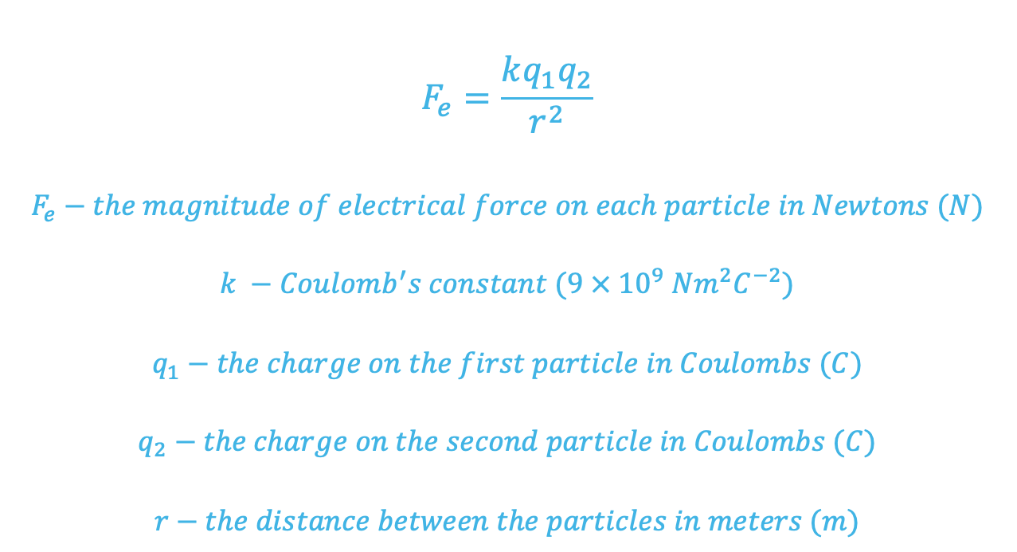
The magnitude of electric force

Slide 4
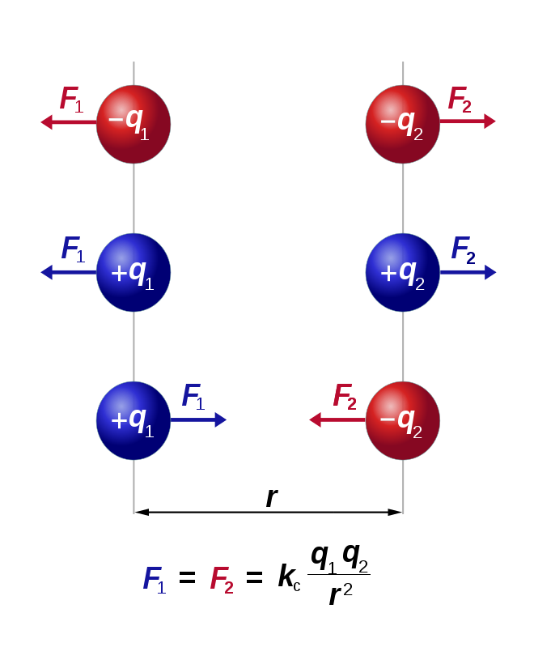
The direction of electric force
The direction of force that each particle experiences will be determined by the nature of the charges interacting.
Law of attraction and repulsion: like charges repel and unlike charges attract.
https://www.pngegg.com/en/png-svdum

Slide 5
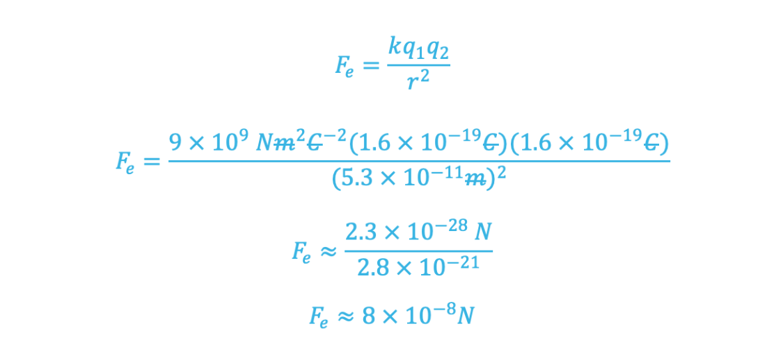
Applying Coulomb’s law
A proton has a charge of +1.6X10⁻¹⁹ C and the charge on an electron is -1.6X10⁻¹⁹ C. Estimate the electric force between these two particles in a hydrogen atom, using the absolute value of their charge, assuming that they are 5.3 X 10⁻¹¹ meters apart.

Slide 6
Electric fields
The concept of a field is used to describe how force will behave in a region around an object. They are used for describing forces that can act at a distance.
Field lines indicate the direction of the force that would be exerted on an object.
Electric fields describe the net electrical force that a positively charged particle will experience in a region.

Slide 7
Key points about electric fields
Electric field lines indicate the direction of force on a positively charge – the field lines point away from positive charges and towards negative charges.
The spacing between electric field lines is a qualitative indicator about the strength of the field – the closer the lines, the greater the force.
The electric field lines represent the total electrical field acting at a representative points – the field lines do not cross.

Slide 8
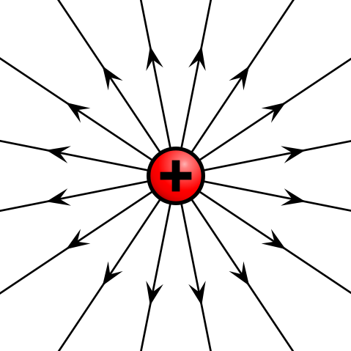
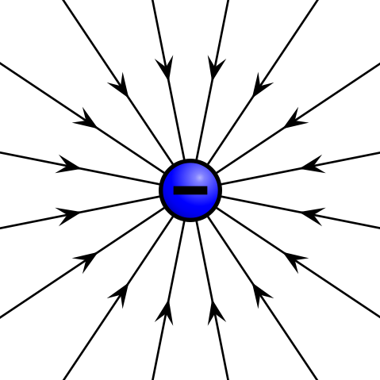
Key point 1 visualized
The electric field around an isolated positively charged particle
The electric field around an isolated negatively charged particle
https://courses.lumenlearning.com/boundless-physics/chapter/the-electric-field-revisited/

Slide 9
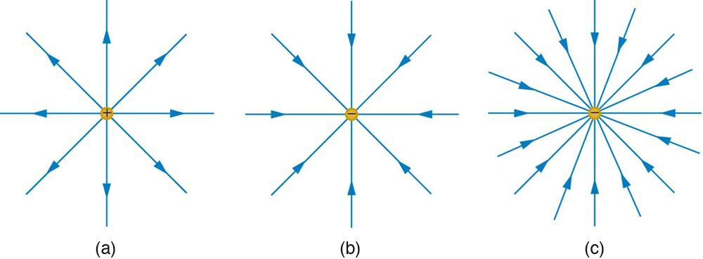
Key point 2 visualized
https://openstax.org/books/college-physics/pages/18-5-electric-field-lines-multiple-charges
The electric field surrounding a positively charged particle.
The electric field surrounding a negatively charged particle with equal charge.
The electric field surrounding a negatively charged particle with greater charge.

Slide 10
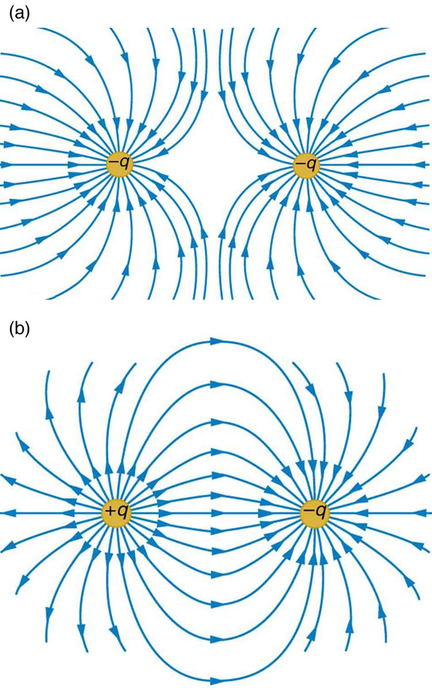
Key point 3 visualized
The field around two negative charges.
The field around a positive and a negative charge.
Note that the fields of the individual charges have combined to give a net field
https://openstax.org/books/college-physics/pages/18-5-electric-field-lines-multiple-charges

